Slide 1
Nutrition Agent
IBM HACKATHON PROJECT
Presented By:
Faculty name :Gopal B Tonchar
College Name & Department : DYPTC FE Math

Slide 2
OUTLINE
Problem Statement
Technology used
Wow factor
End users
Result
Conclusion
Git-hub Link
Future scope
IBM Certifications

Slide 3
Problem Statement
In an era where health awareness is growing, individuals increasingly seek personalized nutrition guidance. However, most existing tools provide generic diet plans, lack real-time adaptability, and fail to consider a person's holistic lifestyle, cultural preferences, allergies, and evolving health conditions. Furthermore, dieticians and nutritionists face limitations in scaling personalized consultations due to time and resource constraints.

Slide 4
Technology used
IBM cloud
Lama-3-3-70b
Model provider – IBM
Arch - ReAct

Slide 5
IBM cloud services used
Cloudstorage
Watsonx
Watsonx studio
Watsonx machine leaerning

Slide 6
Wow factors
It gives personalised nutrition plan

Slide 7
End users
Citizens of India
Patients

Slide 8
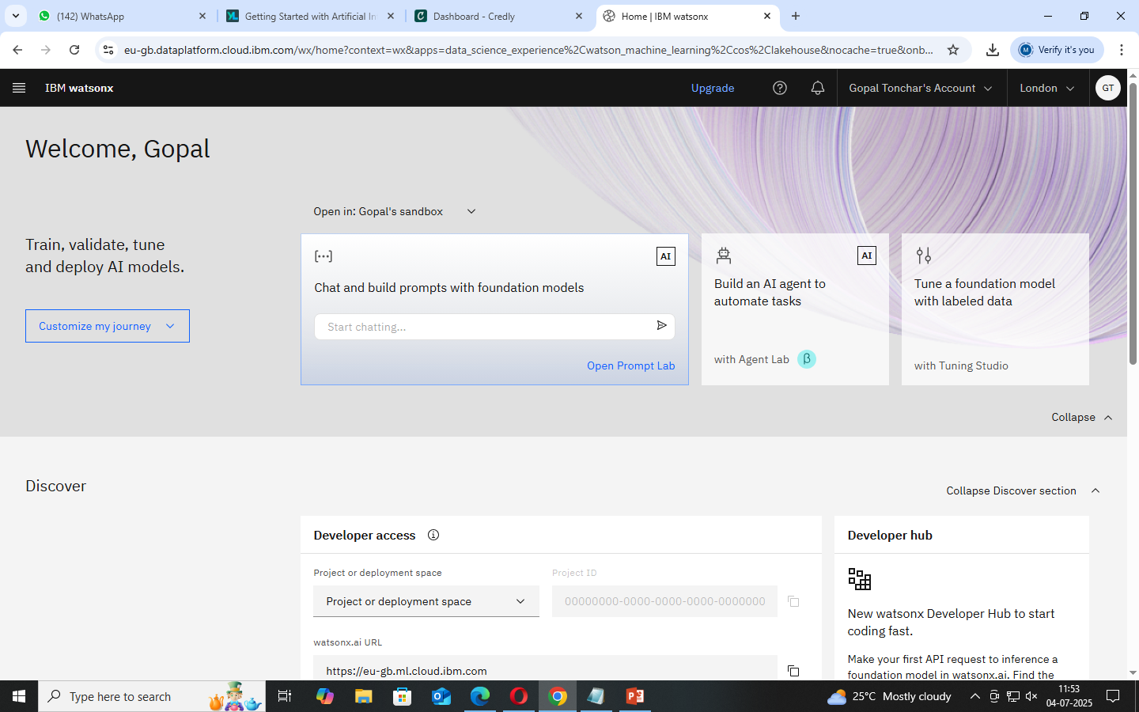
Results

Slide 9
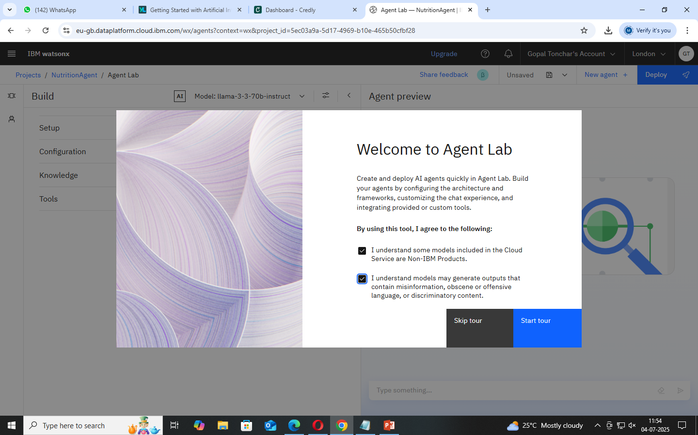
Results

Slide 10
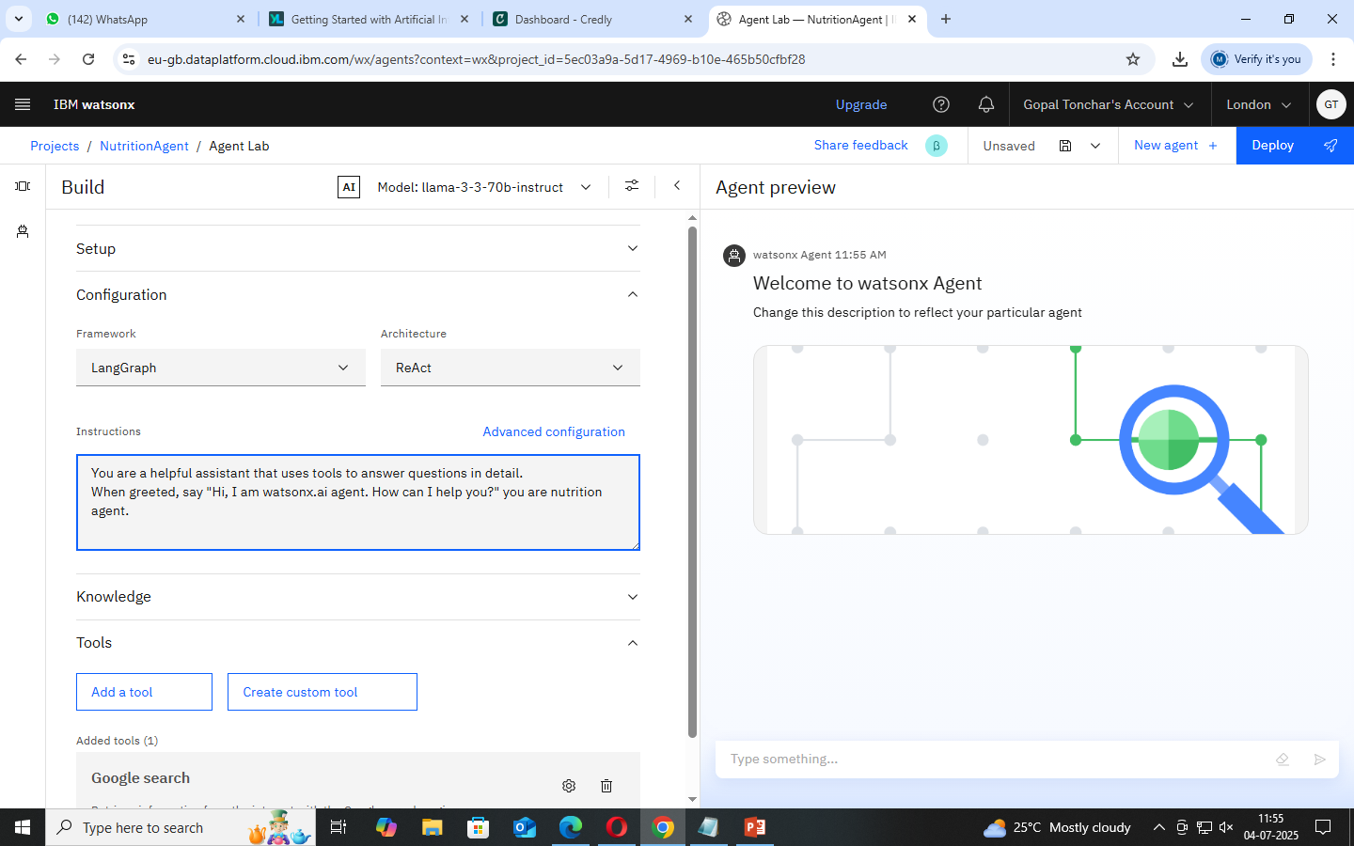
Results

Slide 11
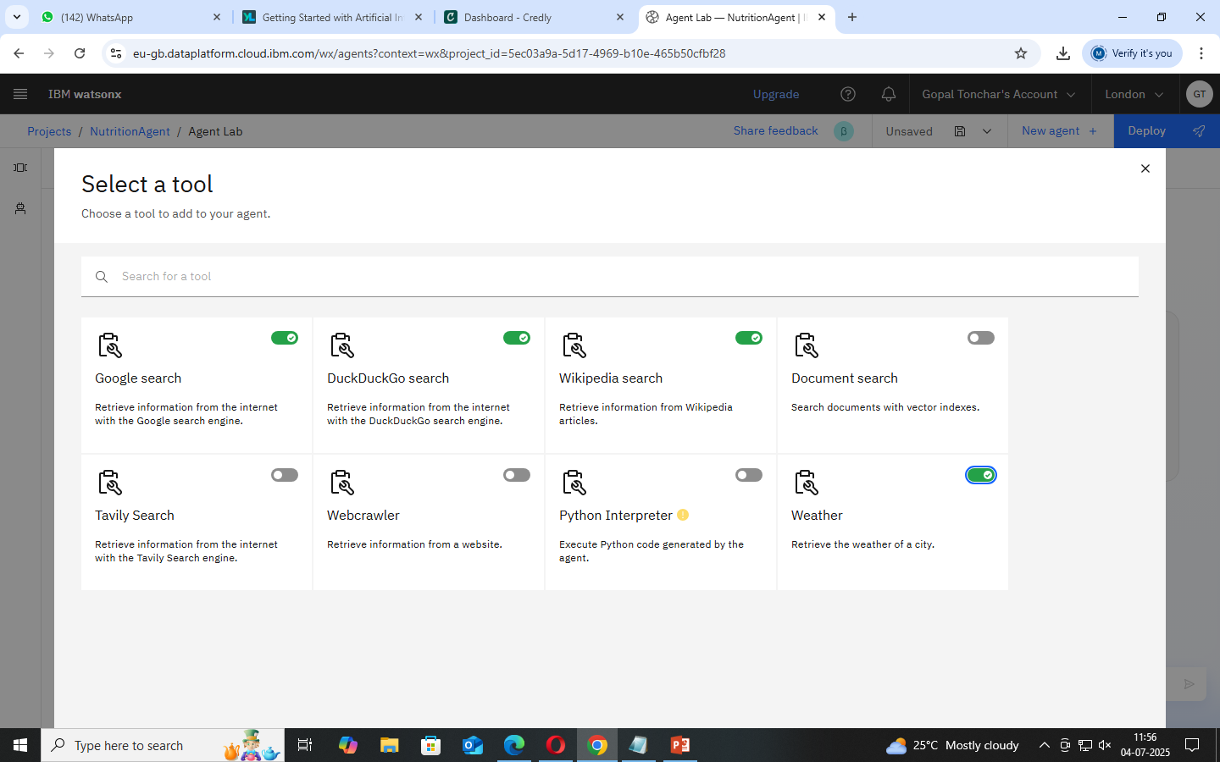
Results

Slide 12
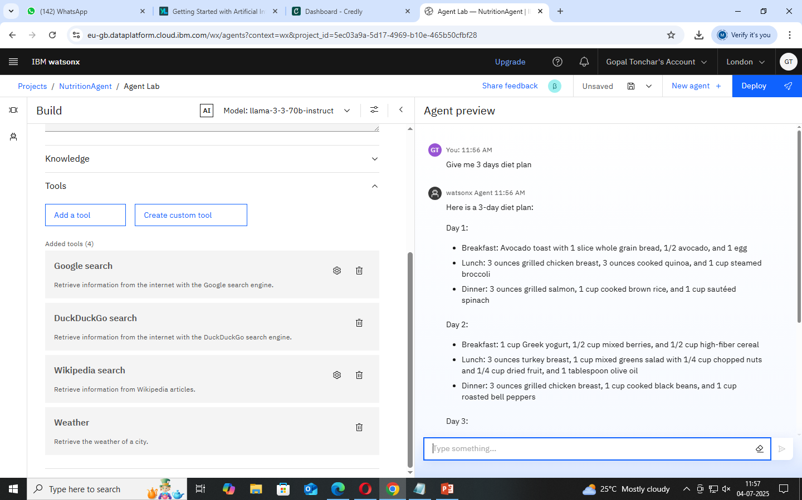
Results

Slide 13
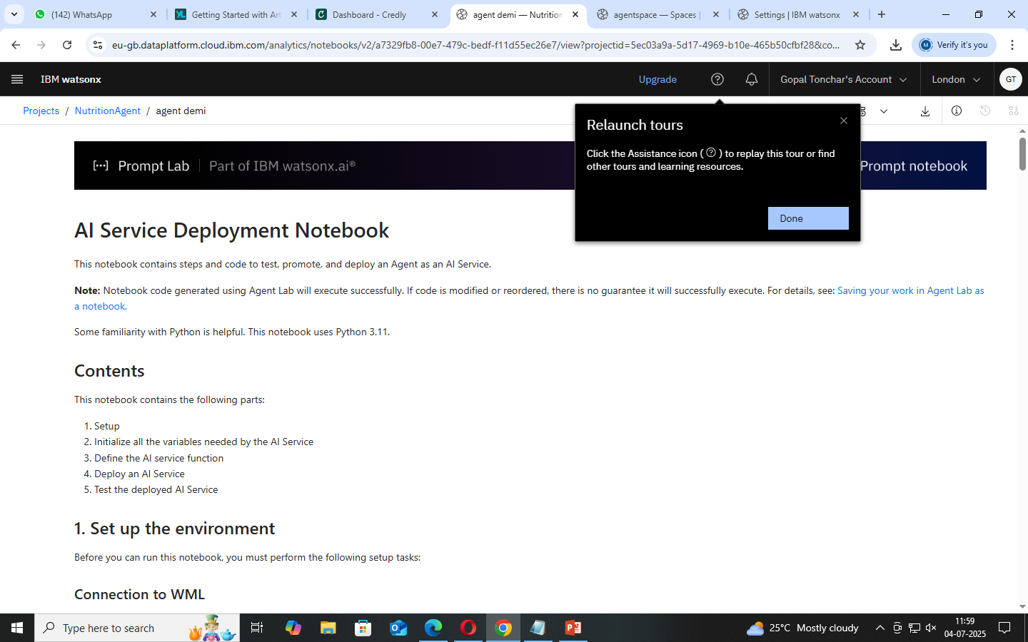
Results

Slide 14
Conclusion
We created the Nurtition AI agent with IBM cloud

Slide 15
GitHub Link
https://github.com/gopaltonchar603/NutritionAgent.git

Slide 16
Future scope

Slide 17
IBM Certifications
Screenshot/ credly certificate( getting started with AI)

Slide 18
THANK YOU

